Slide 1

Provider Management Component
Group 2a

Slide 2

Our 2a Project Group delivered,
The Provider Management Component towards the final project deployed in cloud platform (AWS).
Functionality to create Master Agreement type, provider API & establish Offers.
User will give provider quality as ratings according to the best price offered.
2 February 2024
Aneeta,Sonam,Poonam,Aqib,Gaurav,Prathik
2

Slide 3

Interaction with other Scrum Teams
Deliver APIs to Group 3a and 4a .
Use Offer API from Group 3a
Group 3a API fetched to display in offer page , established offers will be send back to 3a
Integrate group 1 API for our application login as an authorized user.
(User Details API)
2 February 2024
Aneeta,Sonam,Poonam,Aqib,Gaurav,Prathik
3

Slide 4
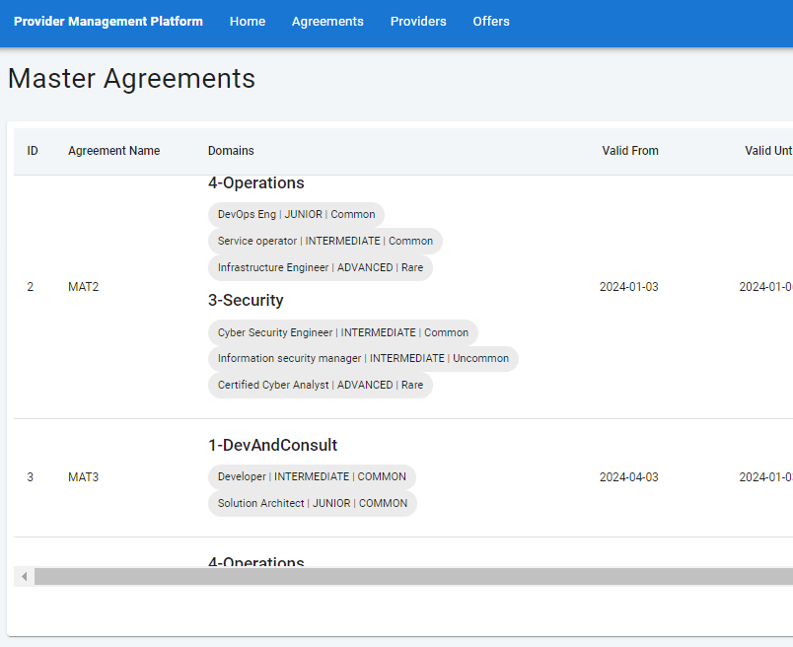
Provider Management Component Architecture
Microservice Architecture
Testing
Standalone Springboot app with embedded server for backend
React & Typescript based Frontend
Relational Database
Dev Testing & UAT Testing
GitHub & Code Review
Dev Testing & UAT Testing
Scalable
Quicker Deployment
Fault Isolation
Deployed in AWS
EC2 S3 RDS
2 February 2024
Aneeta,Sonam,Poonam,Aqib,Gaurav,Prathik
4

Slide 5
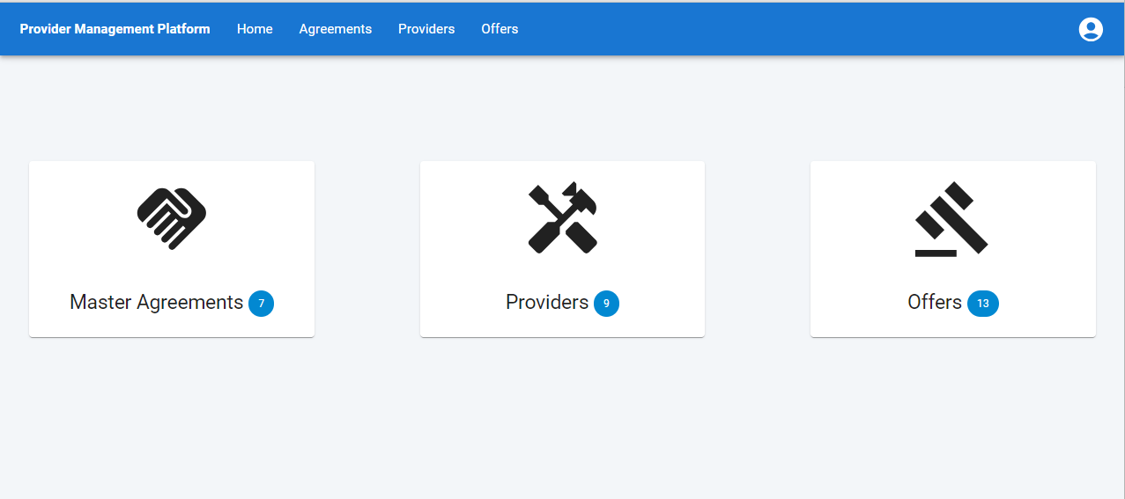
Live Demo
http://agiledevui.s3-website.eu-north-1.amazonaws.com/login
GITHub : 2a_Provider-Management-Component
2 February 2024
Aneeta,Sonam,Poonam,Aqib,Gaurav,Prathik
5

Slide 6



Agile Scrum model
Plan
Collaborate
Development and Delivery
2 February 2024
Aneeta,Sonam,Poonam,Aqib,Gaurav,Prathik
6

Slide 7
Sprint Roadmap
Sprint Backlog & Dev Kick-off
Deployment of Backend APIs to AWS
UI Deployment to AWS
UAT Testing
Nov 24
DEC 08
Dec 22
JAN 2
JAN 8
JAN 12
JAN 15
JAN 18
JAN 20
JAN 22
JAN 25
JAN - 27
2023
2024
SPRINT1
SPRINT2
SPRINT3
SPRINT 4
SPRINT 5
SPRINT 6
Frontend UI app, Backend Java Module, MySQL DB Schema
Gathered Feedback from Customer
Last lap Dev Finetune Functionality of offers, Dev Testing
MVP delivered.
2 February 2024
Aneeta,Sonam,Poonam,Aqib,Gaurav,Prathik
7

Slide 8
Critical Review on our Scrum practices
Scrum Retro and Team Demo
Product Backlog prioritization
-Scrum meeting in alternate days
-Retrospective every sprint end
-Backlog Prioritization, Quick Review
-Story point evaluation.
- Stretch goals in every week
Kanban Board tracking
Need Improvement
-Task moved to Verify after dev completion
-Tested and moved to Done
- Proactive interaction could be better
- Strongly without fear express views
2 February 2024
Aneeta,Sonam,Poonam,Aqib,Gaurav,Prathik
8

Slide 9




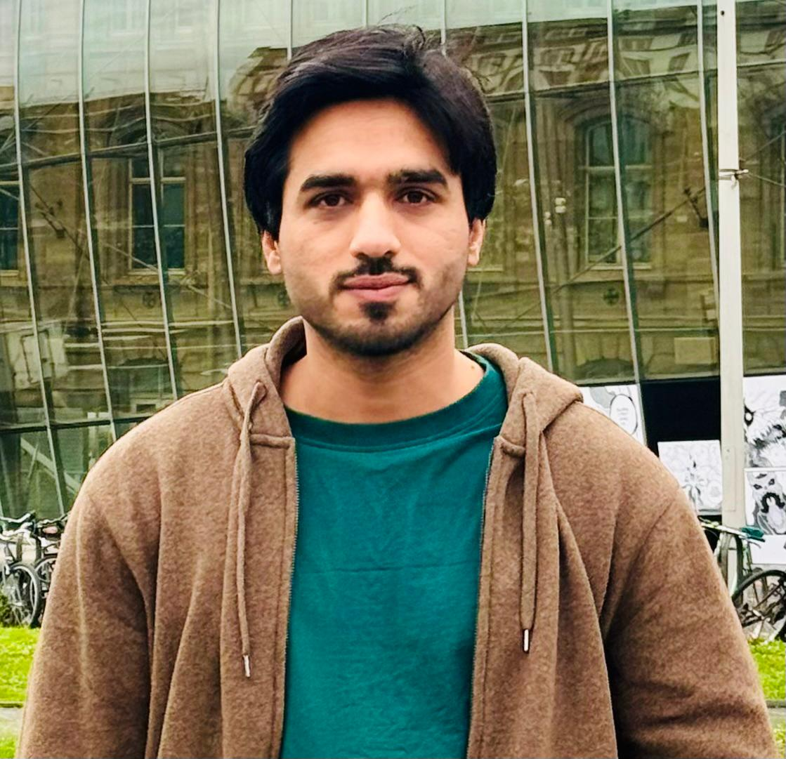

Meet the team
Sonam
Aneeta
Poonam
Pratik
Aqib
Gaurav
2 February 2024
Aneeta,Sonam,Poonam,Aqib,Gaurav,Prathik
9

Slide 10

Thank you from team 2a
2 February 2024
Aneeta,Sonam,Poonam,Aqib,Gaurav,Prathik
10

Slide 11
Any questions?
2 February 2024
Aneeta,Sonam,Poonam,Aqib,Gaurav,Prathik
11

